Slide 1
Balance Sheet
Current Assets | 1988 | 1987
Cash | 415 | 934
Marketable Securities | 1000 | 1000
Accounts Receivables | 3062 | 1833
Inventory | 1980 | 1700
Prepaid Expenses | 123 | 100
Total current assets | 6580 | 5567

Slide 2
Balance Sheet
Non Current Assets | 1988 | 1987
Gross plant & equipment | 11500 | 10000
Accumulated depreciation | 2550 | 1350
Other assets and intangibles | 50 | 50
Total Assets | 15580 | 13667

Slide 3
Balance Sheet
Current Liabilities | 1988 | 1987
Accounts payable | 1594 | 1011
Notes payable | 2210 | 1693
Accrued salaries and wages | 63 | 55
Accrued taxes | 174 | 183
Current portion of long term debt | 220 | 220
Total current liabilities | 4261 | 3162

Slide 4
Balance Sheet
Non Current Liabilities | 1988 | 1987
Bank term loan | 500 | 575
Mortgage | 1355 | 1500
Deferred income tax | 1783 | 1012
Total noncurrent liabilities | 3638 | 3087

Slide 5
Balance Sheet
Share holders equity | 1988 | 1987
Common stock(par value $1.00 ) | 4000 | 4000
Paid –in surplus | 1513 | 1513
Retained earnings | 2168 | 1905
Total shareholders equity | 7681 | 7418
Total liabilities and shareholders equity | 15580 | 13667

Slide 6
Asset Utilization Ratios
Asset utilization ratios, also known as activity ratios, measure management ability to properly utilize the resources allocated to the firm’s fixed assets as well as its current assets.
These ratios are constructed by comparing a balance sheet asset item to an activity variable, such as net sales or cost of goods sold.

Slide 7
Total Asset Turnover
The ratio of net sales divided by tangible assets is also known as asset turnover. This ratio compares the level of net sales for a particular year to the level of tangible total assets allocated to generate those sales .
This ratio calculates the dollar amount of sales generated by one dollar of Assets

Slide 8
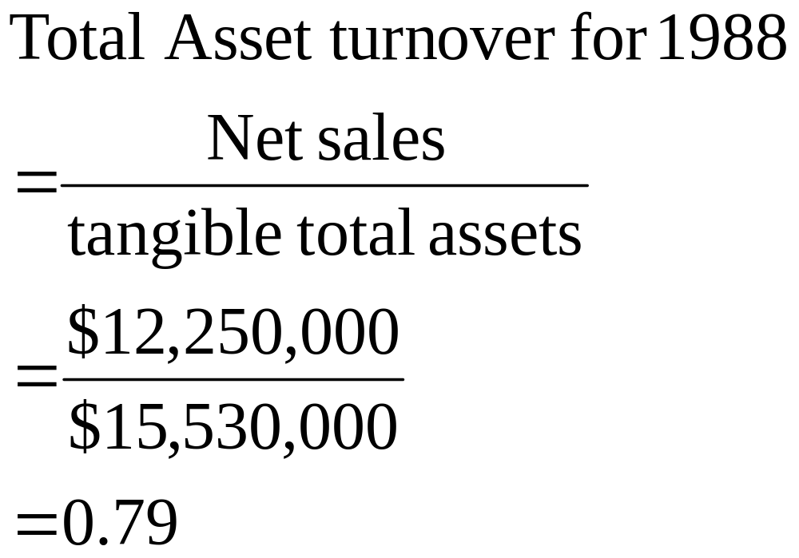
Total asset turnover for 1987=0.81 Industry average = 2.1
A dollar invested in the assets of Daubes produced $0.79 in net sales
In 1988. The second interpretation is that the assets of Daubes
Turned over 0.79 times during 1988

Slide 9
Accounts Receivable Turnover
The accounts receivable turnover is calculated much like the asset turnover ratio except that receivables are substituted for tangible assets

Slide 10
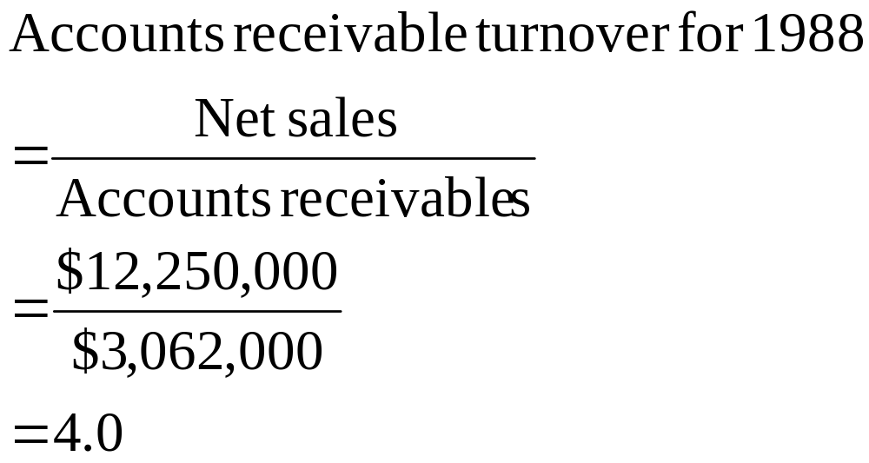

Slide 11
Inventory Turnover
The inventory turnover ratio measures the number of times that the average dollar invested in inventory turns over in a year.
Alarge turnover ratio may also indicate, however that the inventory balance is too small relative to sales and that the possibility of losing sales does exist.
A low turnover ratio on the other hand, may be a sign of too large an investment in inventory

Slide 12
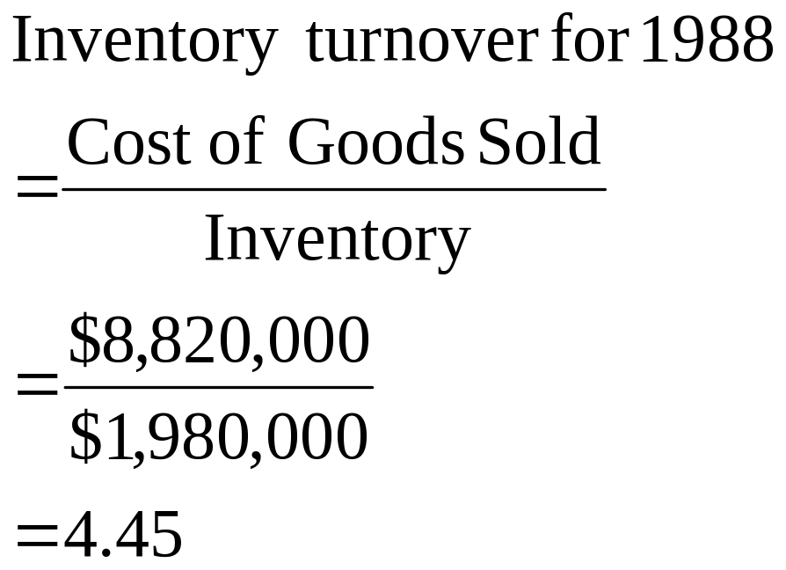

Slide 13
Fixed Asset Turnover
We can calculate a fixed asset turnover ratio to measure utilization of the firm’s investment in fixed assets by dividing net sales by net fixed assets

Slide 14
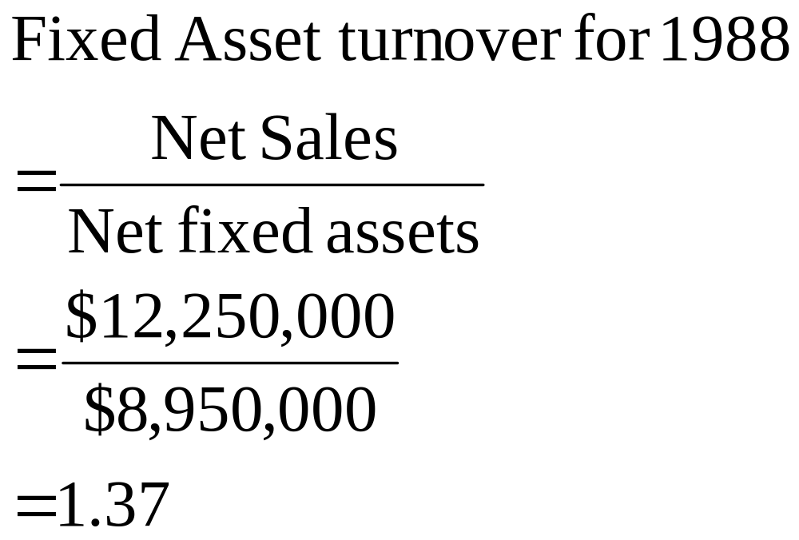

Slide 15
Liquidity Ratios
Liquidity analysis is concerned with a firms ability to repay or cover in short term obligations.
The dollar amount of short term financial obligation can be found in the current liabilities section on the firms balance sheet.
The firm’s ability to cover its obligations is determined by the dollar amount of cash and marketable securities the firm has as well as the dollar amount of funds tied up in its receivables and inventory accounts.

Slide 16
Current Ratio : It is the relationship between the current assets and current liabilities of a concern.
Current Ratio = Current Assets/Current Liabilities
If the Current Assets and Current Liabilities of a concern are Rs.4,00,000 and Rs.2,00,000 respectively, then the Current Ratio will be : Rs.4,00,000/Rs.2,00,000 = 2 : 1
The ideal Current Ratio preferred by Banks is 1.33 : 1
Net Working Capital : This is worked out as surplus of Long Term Sources over Long Tern Uses, alternatively it is the difference of Current Assets and Current Liabilities.
NWC = Current Assets – Current Liabilities

Slide 17
Current Assets : Raw Material, Stores, Spares, Work-in Progress. Finished Goods, Debtors, Bills Receivables, Cash.
Current Liabilities : Sundry Creditors, Installments of Term Loan, DPG etc. payable within one year and other liabilities payable within one year.
This ratio must be at least 1.33 : 1 to ensure minimum margin of 25% of current assets as margin from long term sources.
Current Ratio measures short term liquidity of the concern and its ability to meet its short term obligations within a time span of a year.
It shows the liquidity position of the enterprise and its ability to meet current obligations in time.
Higher ratio may be good from the point of view of creditors. In the long run very high current ratio may affect profitability ( e.g. high inventory carrying cost)
Shows the liquidity at a particular point of time. The position can change immediately after that date. So trend of the current ratio over the years to be analyzed.
Current Ratio is to be studied with the changes of NWC. It is also necessary to look at this ratio along with the Debt-Equity ratio.

Slide 18
3. ACID TEST or QUICK RATIO : It is the ratio between Quick Current Assets and Current Liabilities. The should be at least equal to 1.
Quick Current Assets : Cash/Bank Balances + Receivables upto 6 months + Quickly realizable securities such as Govt. Securities or quickly marketable/quoted shares and Bank Fixed Deposits
Acid Test or Quick Ratio = Quick Current Assets/Current Liabilities
Example :
Cash 50,000
Debtors 1,00,000
Inventories 1,50,000 Current Liabilities 1,00,000
Total Current Assets 3,00,000
Current Ratio = > 3,00,000/1,00,000 = 3 : 1
Quick Ratio = > 1,50,000/1,00,000 = 1.5 : 1

Slide 19
Leverage Ratios
Leverage ratios are designed to assess the balance of financing obtained through debt and equity sources.
These ratios can be separated into two distinct groups: those that measure the relative proportions of debt and equity financing and those that measure the firms ability to service its debt obligation out of current earnings

Slide 20
Times Interest Earned
The times interest earned ratio measures the number of times that earnings before interest and taxes cover or exceed the firms interest expense

Slide 21
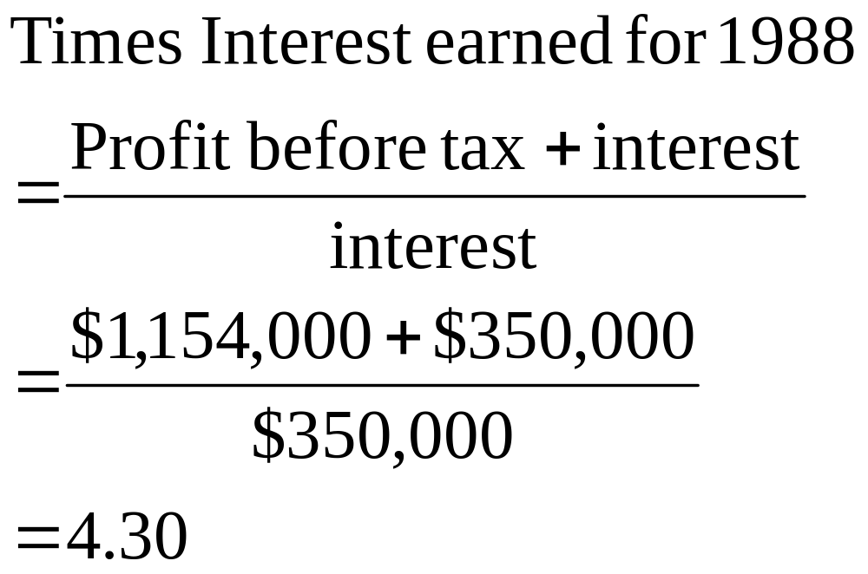

Slide 22
Times Fixed Financial Charges Covered
The times fixed financial charges covered is another coverage ratio but it is more comprehensive because it measures the coverage of all financial charges. In the equation for this ratio T symbolizes the firm’s marginal tax rate, which is assumed to be 40%

Slide 23
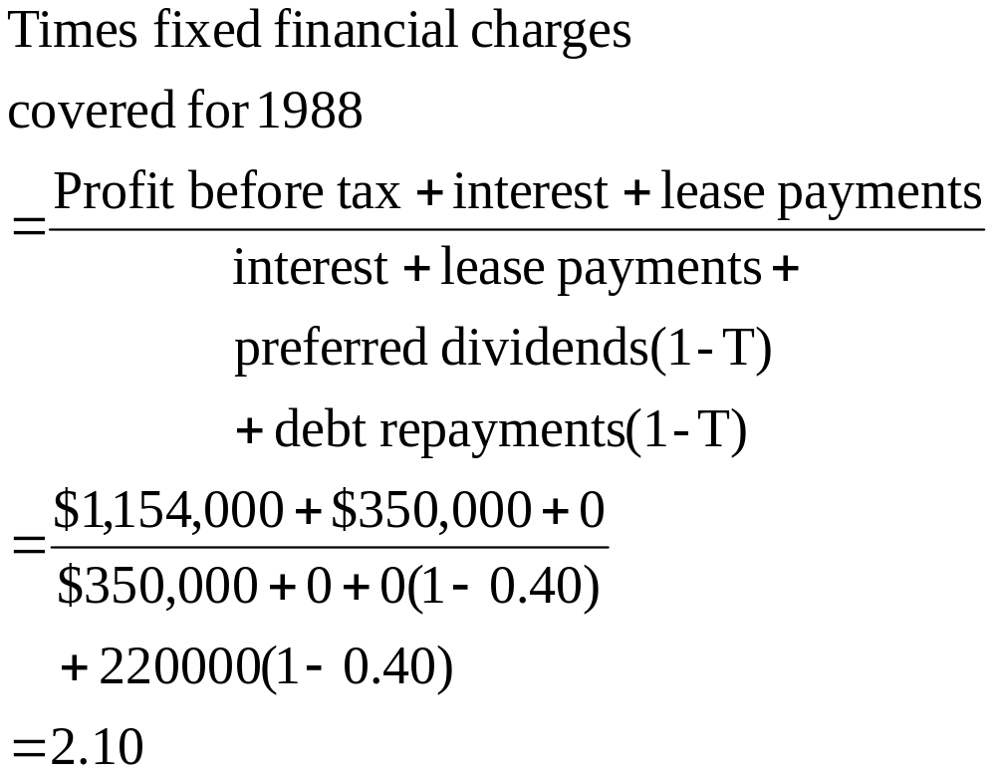

Slide 24
Debt Ratio
The debt ratio measures the proportion of a company’s total financing being supplied by debt sources, such as account payables, bank loans, bonds or mortgages

Slide 25
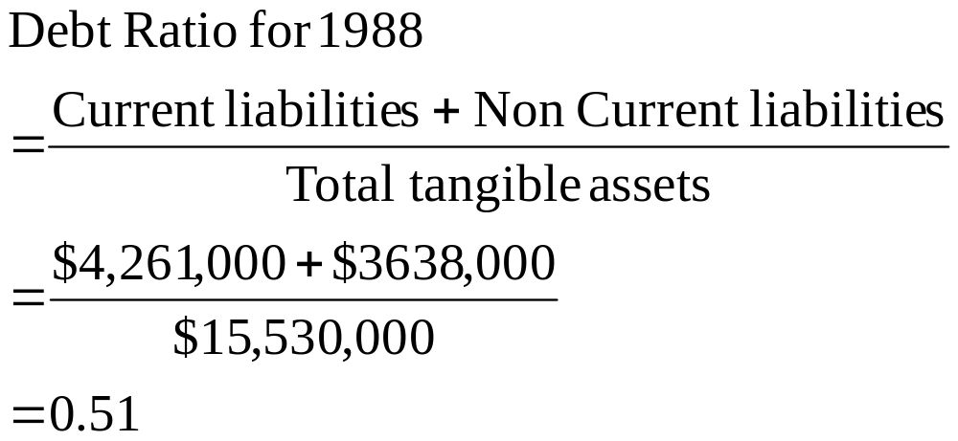
This ratio indicates that in 1988 half of Daubes total financing is
Derived from long and short term debt sources

Slide 26
Debt Equity Ratio
This comparison relates the total dollar amount of debt to the firm’s level of tangibel shareholder equity. Thus we are able to directly assess the number of dollars of debt financing the firm is using per dollar of shareholder equity

Slide 27
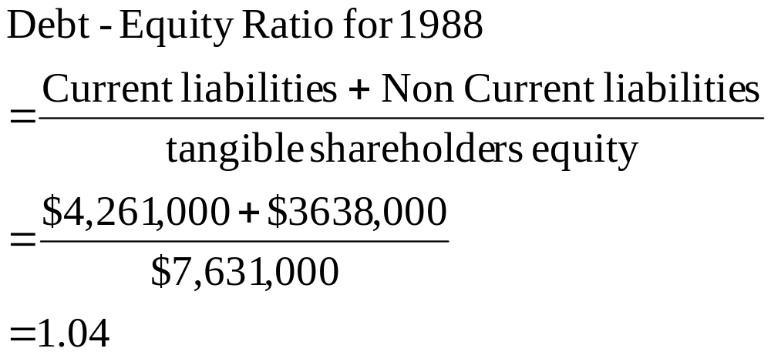

Slide 28
Profitability Ratios
Profit is the difference between revenues earned and expenses.
We can address the degree of firm’s profitabilty from two vantage points. First are the firms costs or expenses appropriate for the level of revenues generated? Ratios with this perspective are known as margin ratios.
Second : Is the firm earning profit relative to the level of resources invested in the firm? These ratios are known as return on Investment Ratios

Slide 29
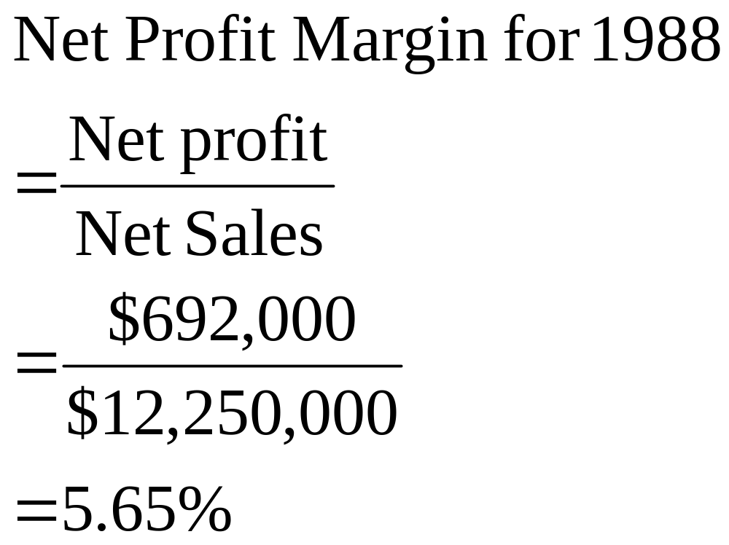
Net Profit Margin

Slide 30
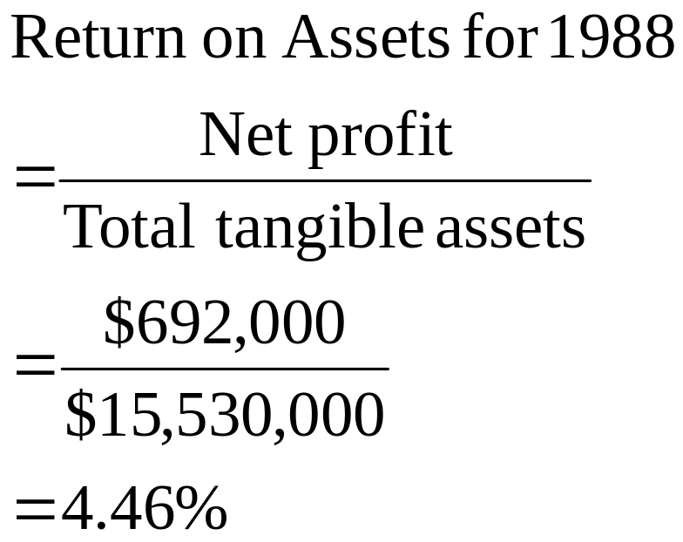
Return on Assets
Measures the profitability of the firm in relation to the dollars it has invested in tangible assets

Slide 31
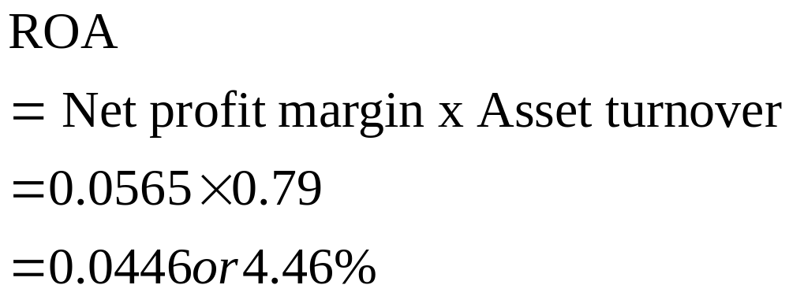
Return on Assets

Slide 32

Return on Equity ROE

